Slide 1
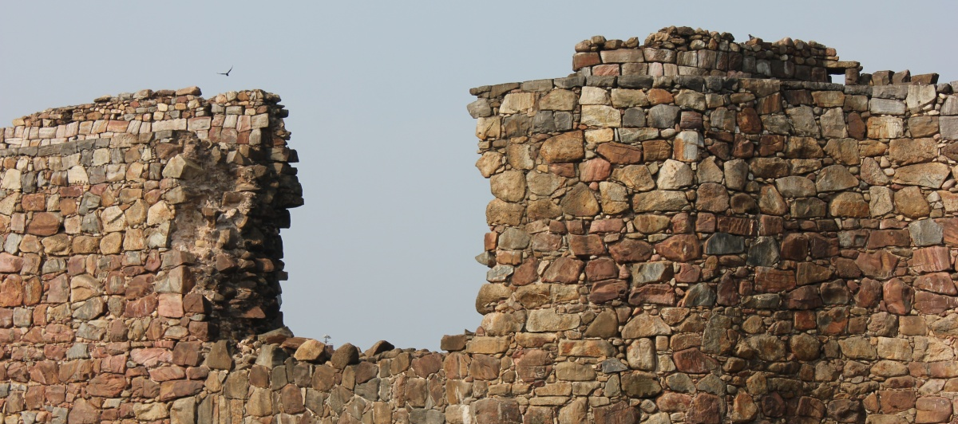
Nehemiah 3

Slide 3
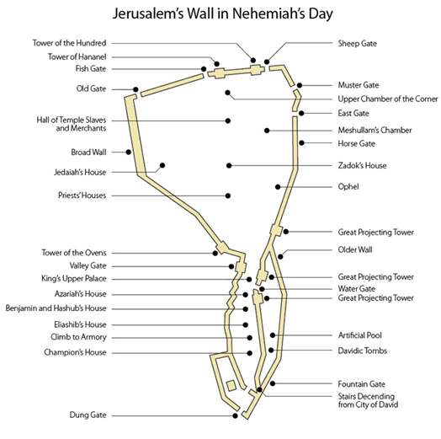

Slide 4
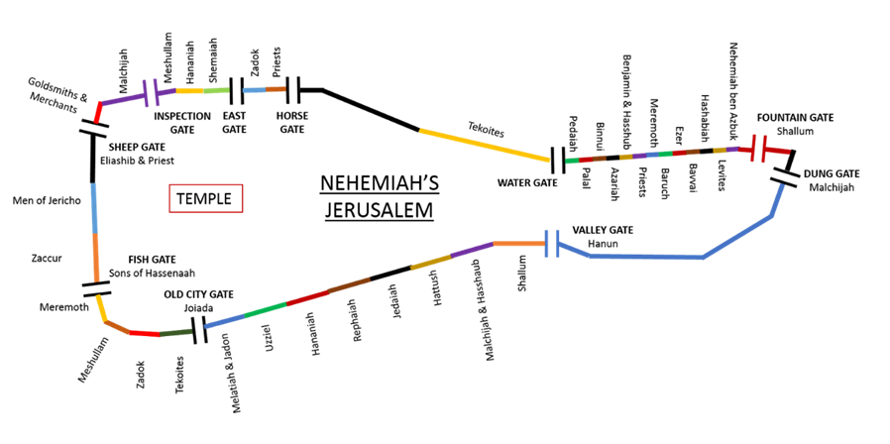

Slide 5
Tune in next week for chapter four’s stunning events…….

